Slide 1
Electronic Instrumentation Section-1, Ppt-14

Slide 2
Reliability of systems

Slide 3
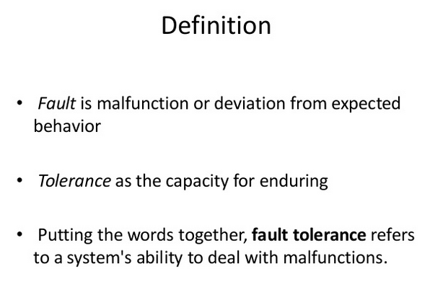

Slide 4
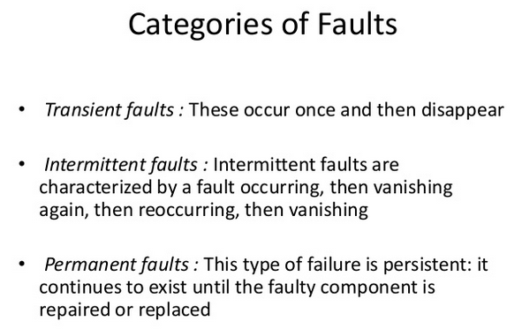

Slide 5
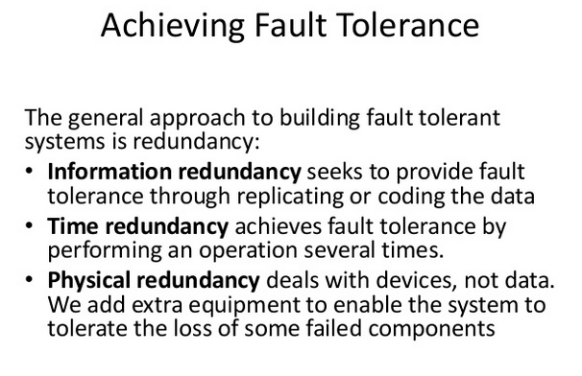

Slide 6
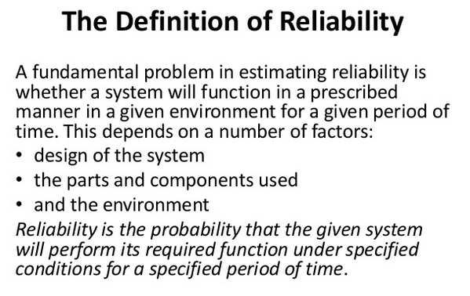

Slide 7
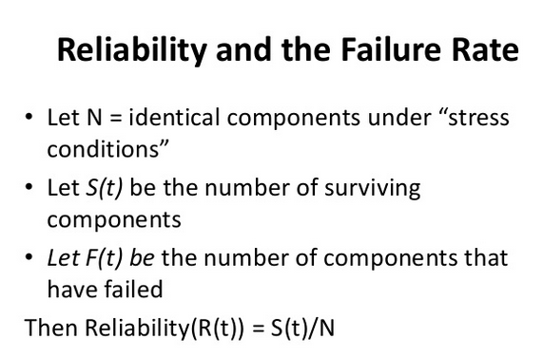

Slide 8
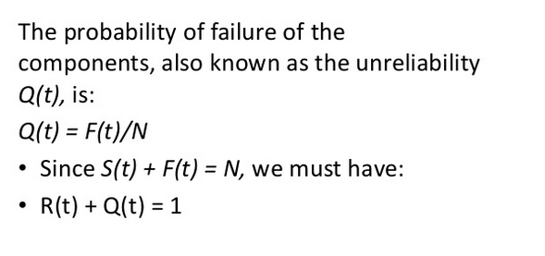

Slide 9
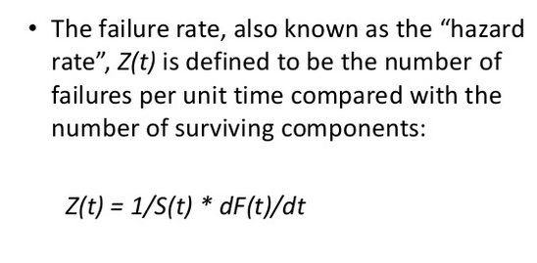

Slide 10
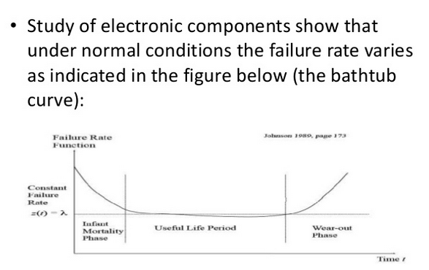

Slide 11

Failure rate over the life of a product
The failure rate is expected to vary over the life of a product – ‘Bathtub Curve’
Infant Mortality
← Useful Life →
Wearout
D
A
B
C
e-Learning course.

Slide 12
Bathtub Curve.
A-B Early Failure / Infant mortality / Debugging / Break-in
‘Teething’ problems. Caused by design/material flaws
Eg: Joints, Welds, Contamination, Misuse, Misassembly
B-C Constant Failure / Useful life.
Lower than initial failure rate and more or less constant until end of life
C-D End of life failure / Wear out phase.
Failure rate rises again due to components reaching end of life
Eg: Corrosion, Cracking, Wear, Friction, Fatigue, Erosion, Lack of PM
e-Learning course.

Slide 14
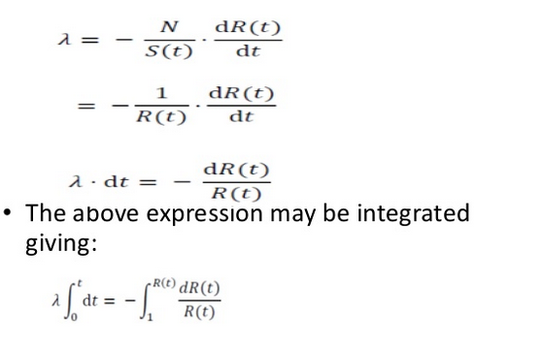

Slide 15
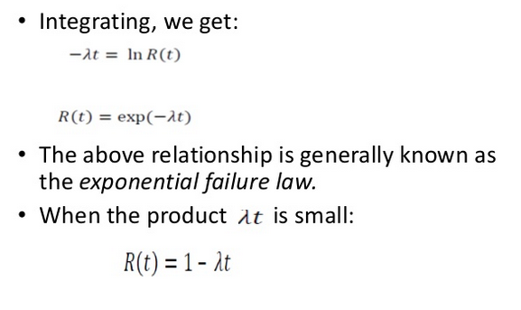

Slide 16
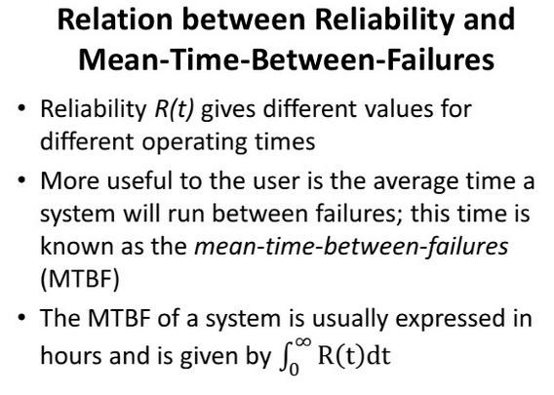

Slide 17
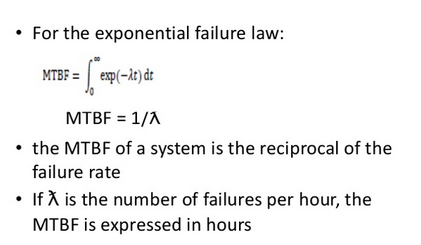

Slide 18
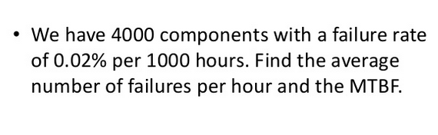

Slide 19
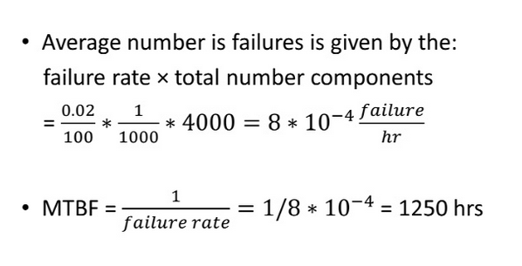

Slide 20
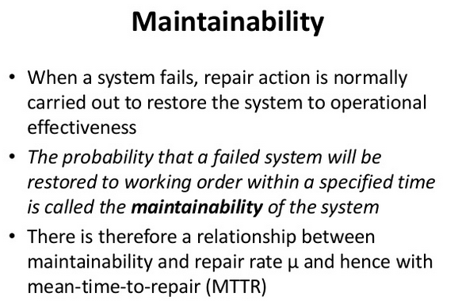

Slide 21
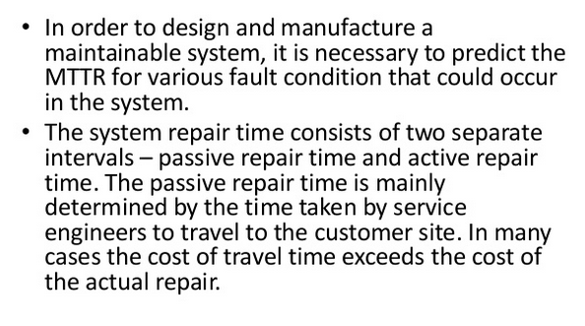

Slide 22
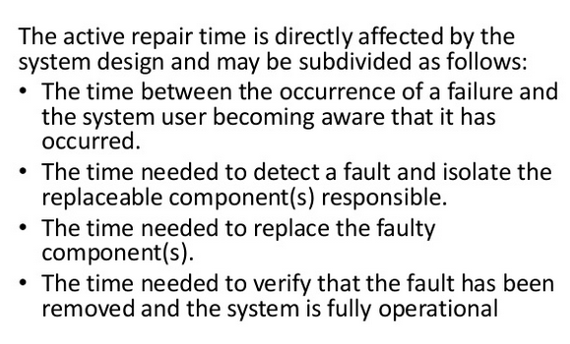

Slide 23
Example
MTBF θ = Total time / Total Number of failures
Average Failure Rate λ = 1 / θ → λ θ = 1
Example:
300 cars have accumulated 45000 hours, 10 failures are observed. What is the MTBF? What is the failure rate?
Note: considering Car as repairable system, Use MTBF
MTBF = 45000/10 = 4500 hours.
Average Failure rate λ = 10/45000 = 0.00022 per hour.
e-Learning course.

Slide 24
Example
10 components were tested. The components (not repairable) failed as follows:
Component 1,2,3,4,5 failed after 75,125, 130, 325, 525 hours. Find the failure rate and mean time till failure..
Solution:
No. of failures = 5
Total operating time = 75 + 125 + 130 + 325 + 525 + 5*525 = 3805
Failure rate λ = 5 / 3805 = 0.001314
Mean time till failure = 1/λ
=1/0.001314
= 761.04 hours.
525
325
130
125
5 x 525
75
Introduction to Reliability Engineering
e-Learning course.

Slide 25
Example:
50 components are tested for two weeks. 20 of them fail in this time, with an average failure time of 1.2 weeks.
What is the mean time till failure assuming a constant failure rate?
Answer:
No. Of failures = 20
Total time = 20*1.2 + 30*2 = 84 weeks
Failure rate = 20/84 = 0.238/week
Mean time till failure is estimated to be = (1/failure rate)
= 1/0.238 = 4.2 weeks.
Introduction to Reliability Engineering
e-Learning course.

Slide 26
Thank you

